Slide 1

RWE – Data Management Platform Integration
Feb, 2025

Slide 2
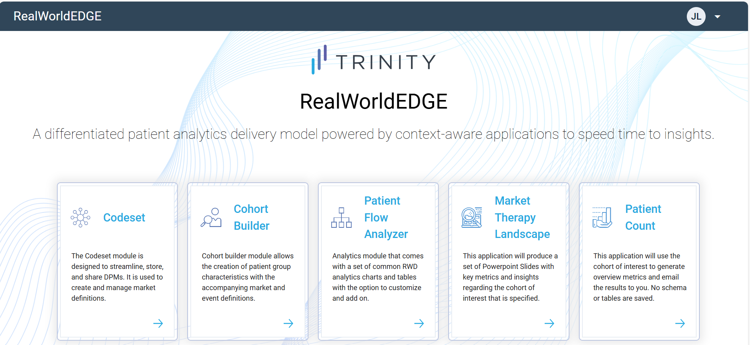
RWE Landing Screen – AS IS

Slide 3
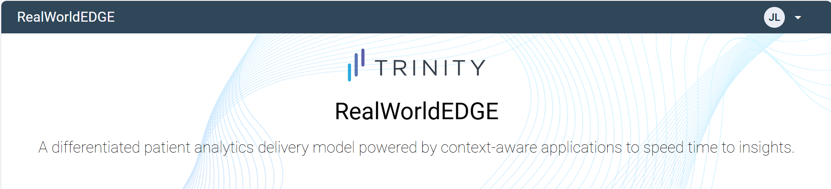
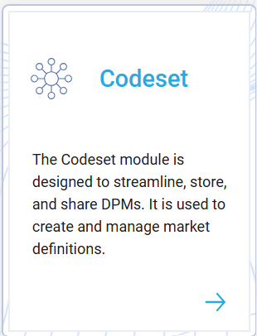
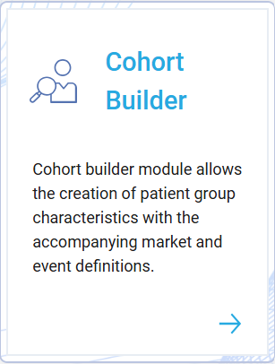
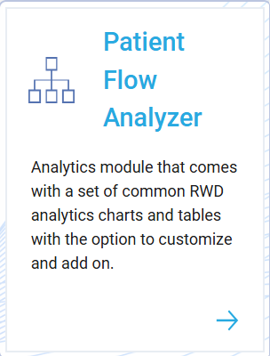
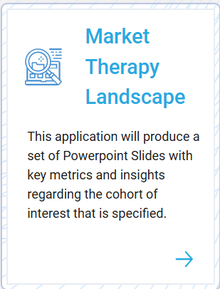
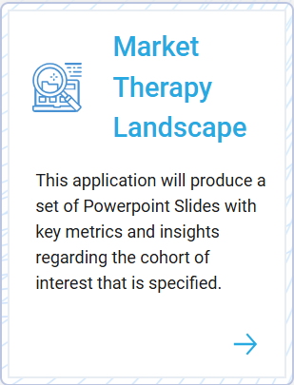
RWE Landing Screen – TO BE
Data Management
This application can process/transform the source data as per the requirement of the CDM
TERRA To be Integrated

Slide 4
Integration Approach & Design

